Slide 1
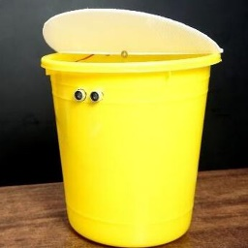
An ultrasonically operated automatic lid opening and closing dustbin.
Malshika Gayathri Peiris
IT20147396

Slide 2

Table of contents
01
02
03
04
05
06
Introduction
Problem and Solution
Marketing Oppotunity
Competitive Analysis
Business Model
Traction and Milestones

Slide 3
Table of contents
07
08
09
10
Financial Projections
Team
Ask
Risk Mitigation

Slide 4
01
Introduction
An ultrasonically operated automatic lid opening and closing dustbin.

Slide 5
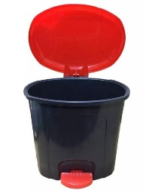
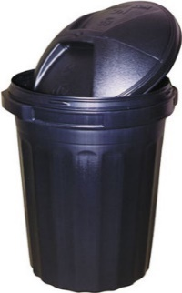
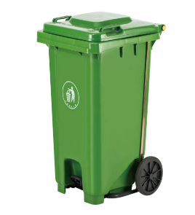
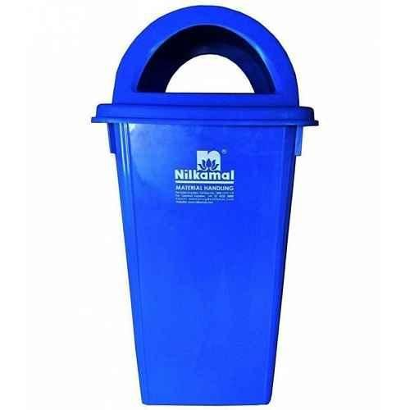
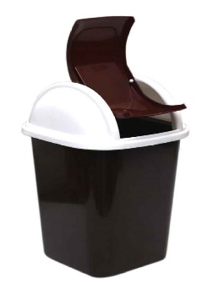
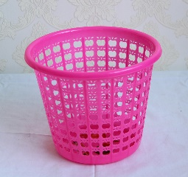
02
Problem and Solution

Slide 6
Problem

Slide 7
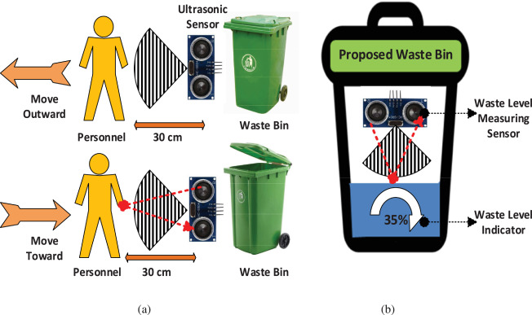
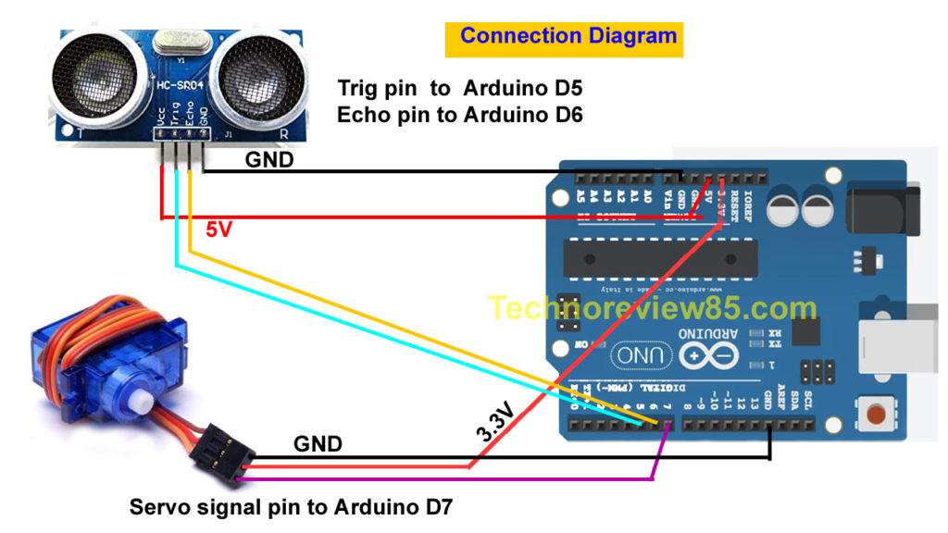
Solution
Introduce An ultrasonically operated automatic lid opening and closing dustbin.

Slide 8

Marketing Opportunity
03

Slide 9
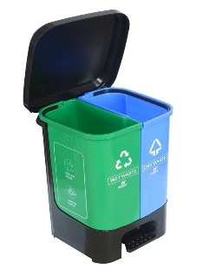
04
Competitive Analysis
Buy Nilkamal 100 Litre Blue Virgin Plastic Dustbin.
Kuber Industries Plastic 3 Pieces Medium Size Swing Dustbin/Swing
KOLORR Twin Bin 18L Dustbin Dry & Wet Waste Pedal Dustbins
240 Liter Plastic Dustbin with 2 Wheels
Daxer Plastic Dust Bin Normal (DDB 01)
70 - 90 Litre Fibre Black Dustbin
Plastic Pedal Dustbin/ Bucket

Slide 10

05
Business Model

Slide 11
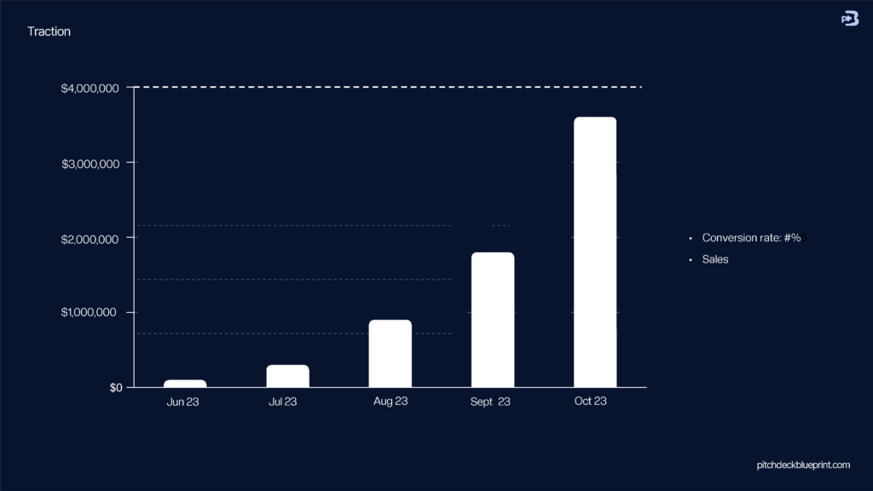
Traction and Milestones
06

Slide 12
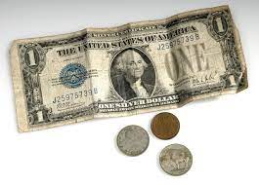
07
Financial Projections

Slide 13

Team
08

Slide 14

09
Ask

Slide 15

10
Risk Mitigation

Slide 16

Thanks
Malshika Gayathri Peiris
IT20147396

